Slide 1

Real-time QuickNets
Devdhar Patel

Slide 2
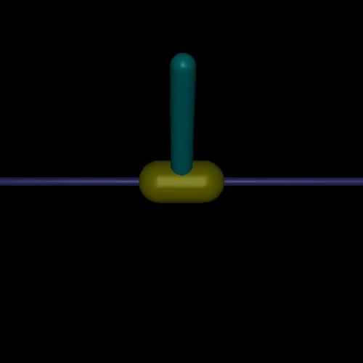
Change timestep (balance global time)
Environment parameters:
Agent Reaction time: 40 ms*
Force: -3, 3
Episode parameters:
Maximum steps: 1000*
Reward per step: 1
Max total reward: 1000*
Algorithm parameters:
Initial timesteps to sample: 25000*
Maximum timesteps: 100000*
Update steps: 75000*

Slide 3
InvertedPendulum-v2
Added force parameters:
Frequency: every 50-100 timesteps (2-4 seconds)
Duration: 20 ms
Force: (0, 5 * g)
Direction: Left or right

Slide 4
State
Position of the Slider
Angle of the hinge
Velocity of the slider
Angular velocity of the hinge

Slide 5
g_force response_rate reward
0 0.0 0.01 4025.2
1 0.0 0.02 2026.0
2 0.0 0.04 1026.2
3 0.0 0.08 513.6
4 0.0 0.16 204.0
5 0.0 0.32 59.2
6 0.0 0.64 10.8
7 0.0 1.28 2.8
8 1.0 0.01 4025.8
9 1.0 0.02 2026.0
10 1.0 0.04 1025.6
11 1.0 0.08 514.7
12 1.0 0.16 40.1
13 1.0 0.32 19.9
14 1.0 0.64 5.3
15 1.0 1.28 3.8
16 2.0 0.01 4025.8
17 2.0 0.02 2026.2
18 2.0 0.04 1026.0
19 2.0 0.08 512.5
20 2.0 0.16 246.1
21 2.0 0.32 45.4
22 2.0 0.64 9.0
23 2.0 1.28 2.8
24 3.0 0.01 4025.8
25 3.0 0.02 2026.6
26 3.0 0.04 1025.8
27 3.0 0.08 339.7
28 3.0 0.16 204.1
29 3.0 0.32 35.1
30 3.0 0.64 7.1
31 3.0 1.28 2.8
32 4.0 0.01 799.4
33 4.0 0.02 2025.8
34 4.0 0.04 1026.4
35 4.0 0.08 514.6
36 4.0 0.16 159.9
37 4.0 0.32 20.0
38 4.0 0.64 5.6
39 4.0 1.28 3.2
40 5.0 0.01 812.8
41 5.0 0.02 2025.6
42 5.0 0.04 1026.0
43 5.0 0.08 206.3
44 5.0 0.16 91.8
45 5.0 0.32 25.5
46 5.0 0.64 5.6
47 5.0 1.28 2.6

Slide 6
Design Ideas to Improve Agent Balance and Stability
Vary reward based on angle correction accuracy
(0.01, -0.01 radian) – highest reward
(0.1, - 0.1 radian) – medium reward
(0.15, -0.15 radian) – small reward
Have angular velocity sensor that projects to a reflex network and a longer response network, and sends
High velocity triggers reflex network that immediately counter act air gust with opposing force
Velocity below the threshold would go to main network
A test of learning this strategy/reflex mechanism would be to see if the agent uses the reflex in higher force (5G +) compared to lower force (1G)
Create a midline separation of the agent and have counterbalancing left and right networks
Use reciprocal inhibition
Use two velocity sensor neurons on the top left and right corner to differentiate if the force is coming from the left or right – opposite side with higher force is activated to balance the agent
Slide credit: Francesca Walsh

Slide 7
Reflex output working at 0.02
Overall output working at 0.16
Possible configurations:
Reflex activating 8 times before main action
Reflex activating once and the same action is repeated until the main action is picked
In the second config, the output can inhibit the reflex
Reflex output (prior knowledge)
-50
50
1
-1
S_0
S_1
S_2
S_3
[-3,3]
256 + 2
256
https://openaccess.thecvf.com/content_CVPR_2019/papers/Morgado_NetTailor_Tuning_the_Architecture_Not_Just_the_Weights_CVPR_2019_paper.pdf
Reference for prior knowledge:
On the Measure of Intelligence Francois Chollet ∗

Slide 8
Data collected
Response rates = [0.01, 0.02, 0.04, 0.08, 0.16, 0.32, 0.64, 1.28]
Forces = [0, 1, 2, 3, 4 ,5]
5 seeds
= 8* 6 * 5 = 240 models

Slide 9


Real-time RL needs to be delay aware
Environment paused
Environment simulating
Traditional RL
s₀
a₀
s₁
a₁
s₂
a₂
s₀
a₀
s₁
a₁
s₂
a₂
Real-time RL
s₀
a₀
s₁
a₁
a₂
s₂
s₃
No action
a₀
a₁
a₂
s₁
s₂
s₃

Slide 10

Current Hardware needs to process much faster than required
Image Signal Processor (ISP) | 1.5 Gigapixels/s
 | Video encoder | Up to 1.2 GPix/s
 | Video decoder | Up to 1.8 GPix/s
 | Memory Bandwidth (256-Bit LPDDR4) | 136 GB/s
Two “Turing” Discrete GPUs (DRIVE AGX Pegasus) | Turing discrete GPU (TU104 SXM2) | 130 TOPS (INT8) | 8.1 TFlops (FP32) connected to Xavier SoC over NVIDIA® NVLink™ (20 GB/s)
 | Discrete GPU Memory Bandwidth | 384 GB/s

Slide 11
Multi-exit NN needs to be delay aware
With one exit:
Response rate: How long the action is performed in the environment for -> 80ms
One can assume that this is analogous to the response rate in a setting where we can get the predicted value of the next state while the action is being performed.
With multiple-exit:
Response rate becomes convoluted in the same setting.
Example, if we choose the early exit:
It has to be performed either for 60ms or 100 ms while the previous action is only performed for 20ms.
This would mean that the input to the neural network has if we want to pick the 20ms exit, will be t+20ms and if we want pick the last exit will be t+80ms. Each exit will operate on different input??
80 ms
20 ms

Slide 12
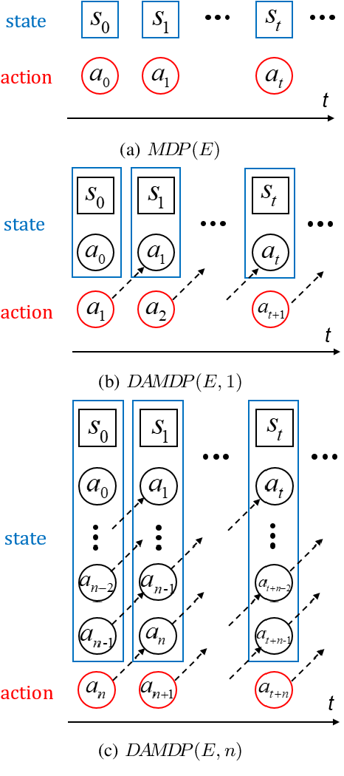
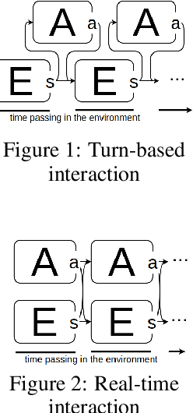
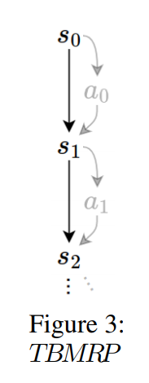
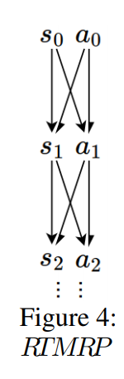
Most common solution
The only change is that the action is picked based on the previous action and current state instead of the current state.

Slide 13
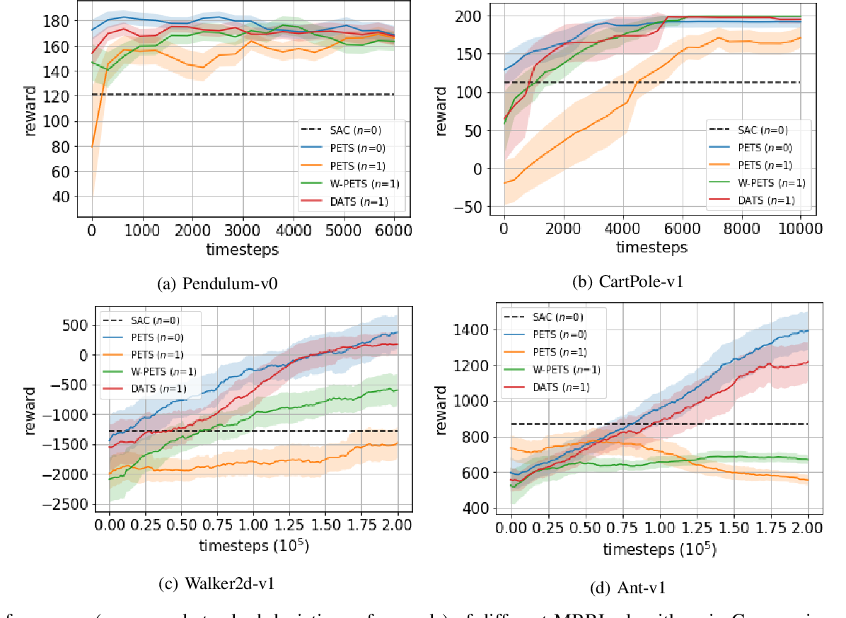

Slide 14
Proposed Model
Early exit: Quick response action to prevent immediate harm.
Exit: Trained on top of the early exit for the RL task
Late exit: Trained on top of the exit to predict the next sequence of actions of the exit. This way, using late exit saves energy and faster response given the
a
a
(a, a, a, a, a)
reflex
response
planning

Slide 15
Delayed Action (white -> original state)
Position of the Slider
Angle of the hinge
Velocity of the slider
Angular velocity of the hinge
Action picked for this timestep

Slide 16
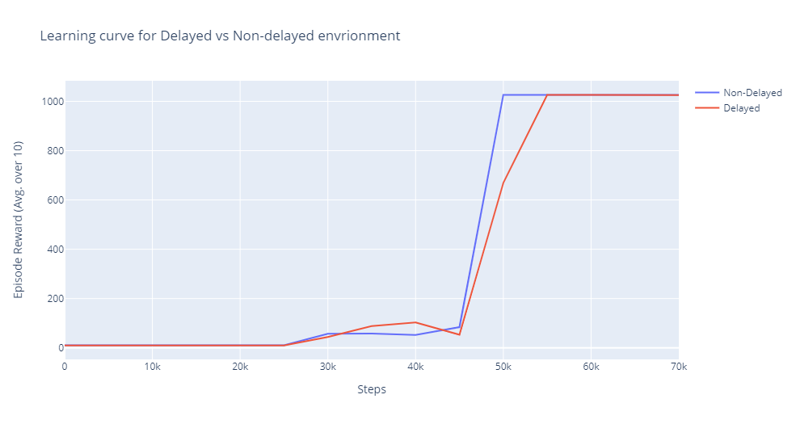
Response time: 40ms
No perturbations

Slide 17
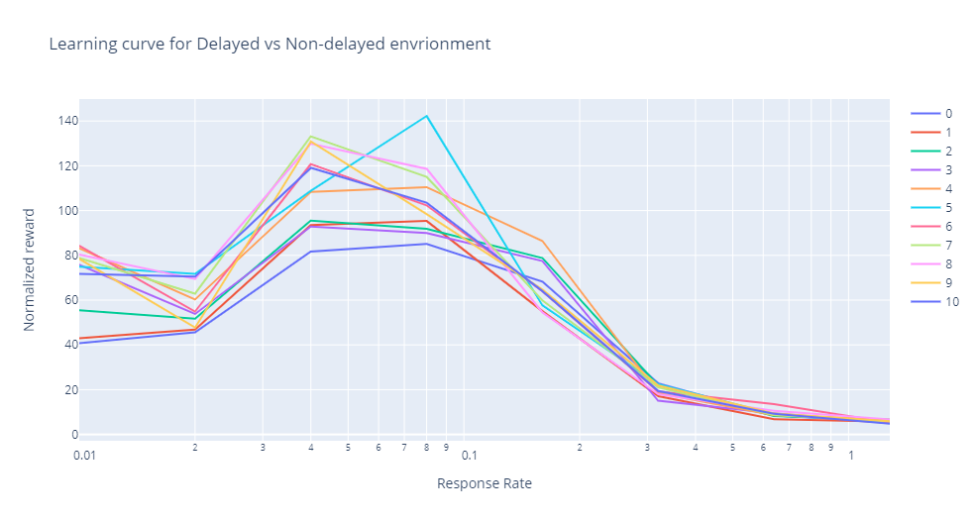

Slide 18
Reflex Network
Algorithm:
Process current state to get action.
If Reflex:
Do previous action for 0.02 seconds
Do reflex action for 0.06 seconds
Else:
Do previous action for 0.08 seconds
Previous action = action
Reflex output (prior knowledge)
-20
20
1
-1
S_0
S_1
S_2
S_3
Reflex:
Reflex action happens at angle > |0.15|.
Therefore, it happens for 25% of all states.
256 + 2
256

Slide 19
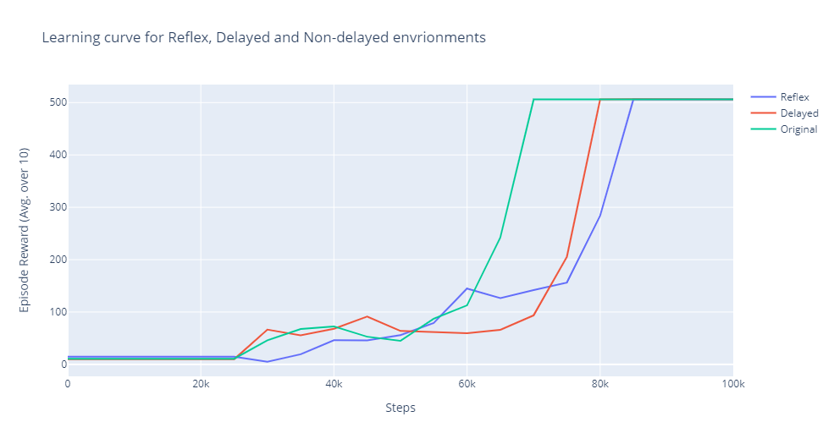

Slide 20
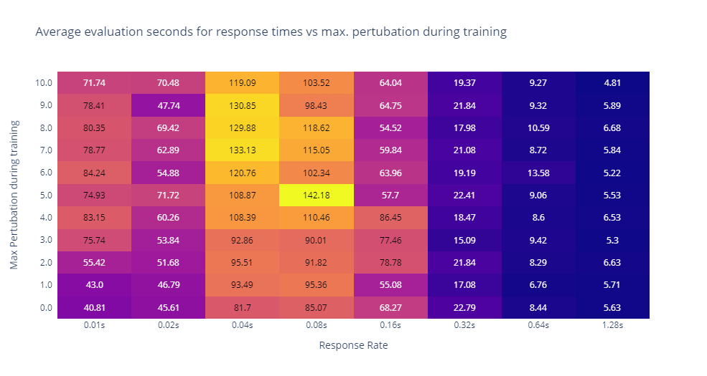

Slide 21
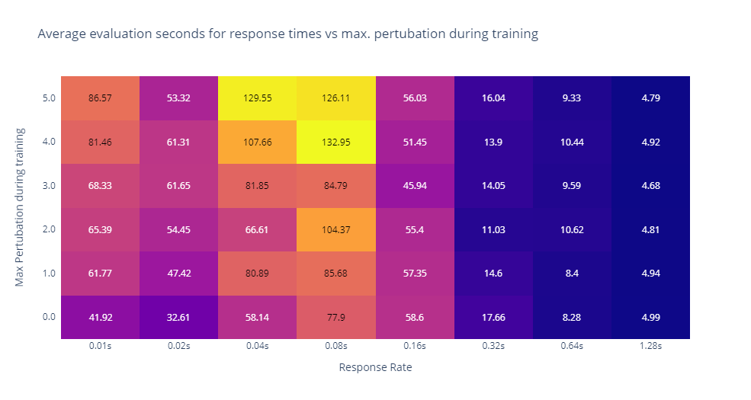
Non-Delayed
Delayed Response

Slide 22
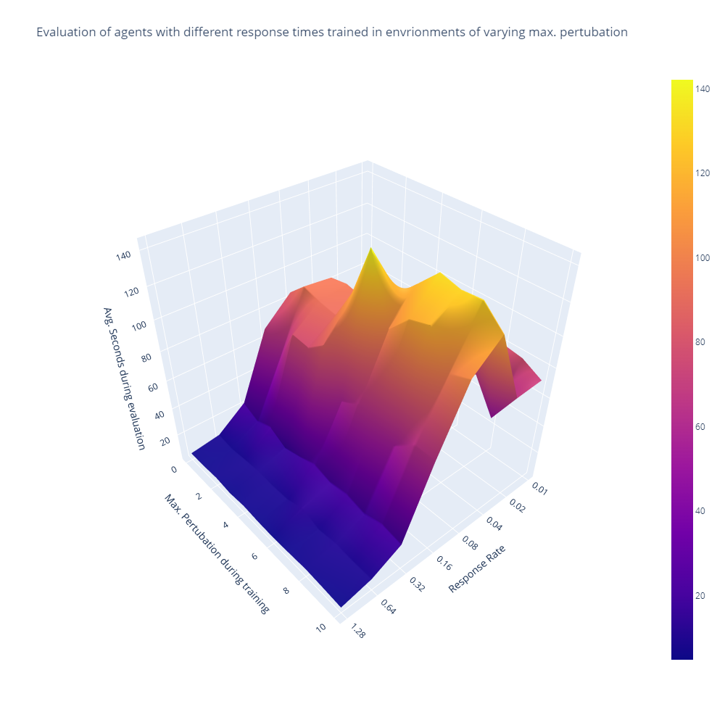
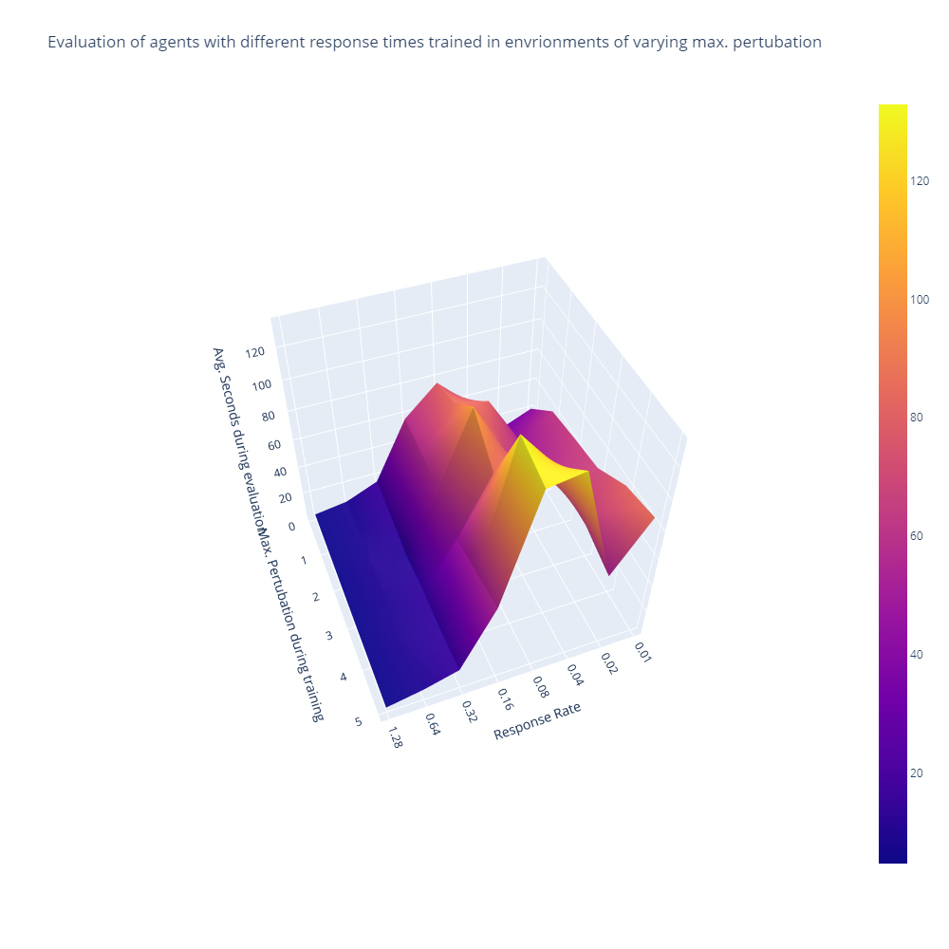
Delayed
Non Delayed

Slide 23
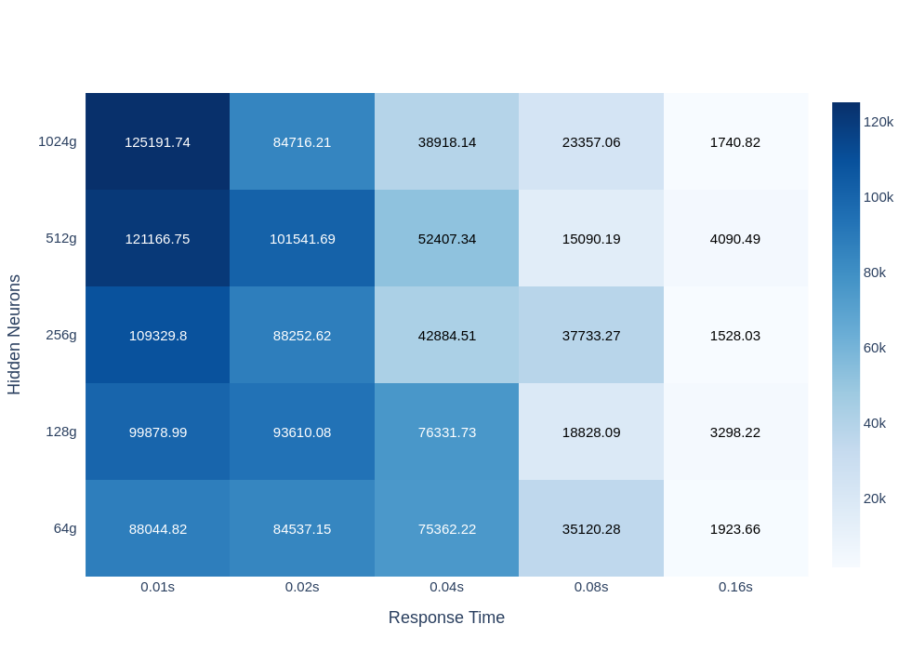
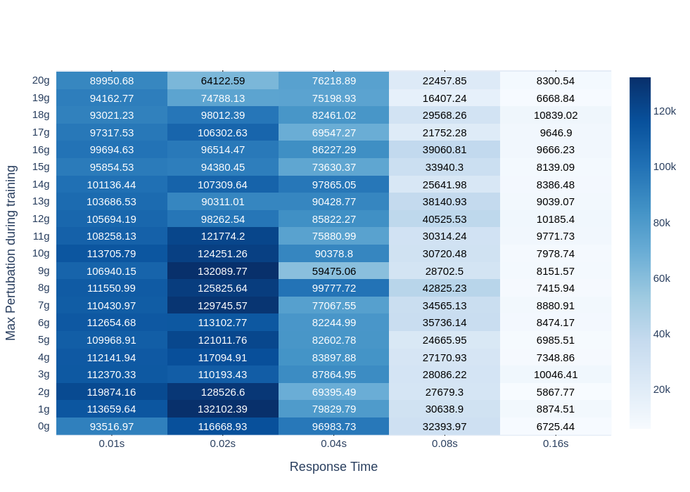
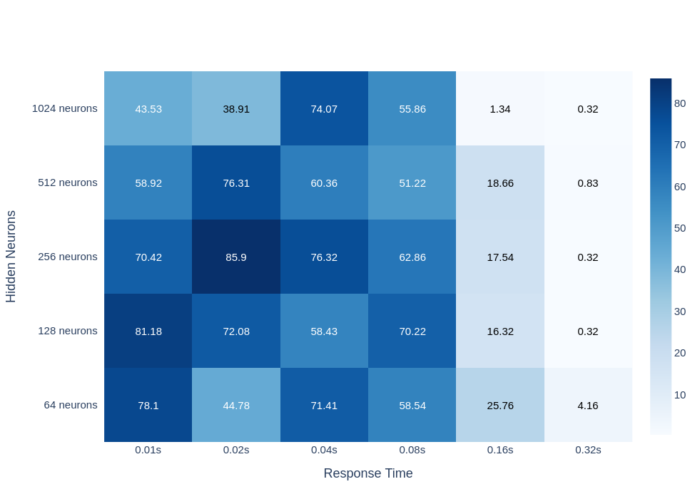
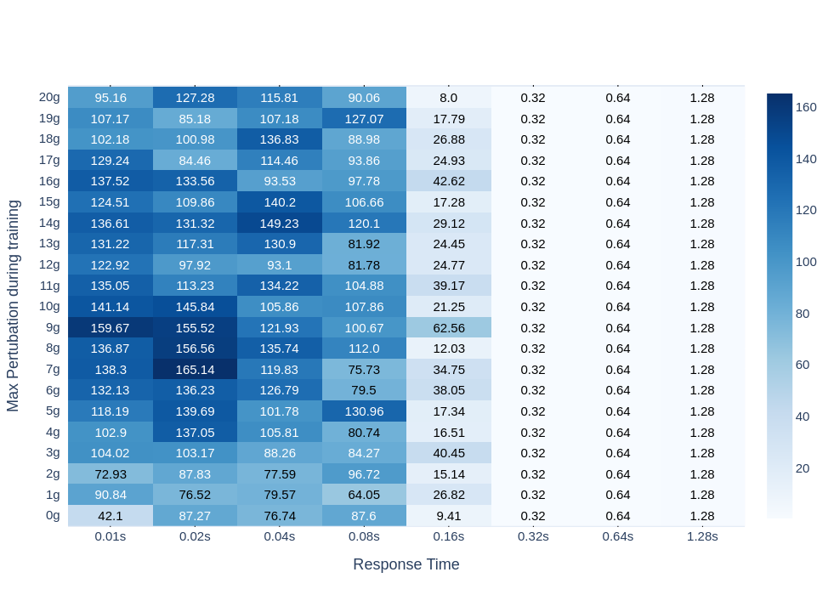
InvertedPendulum-V2 Reward / Survival time in seconds

Slide 24
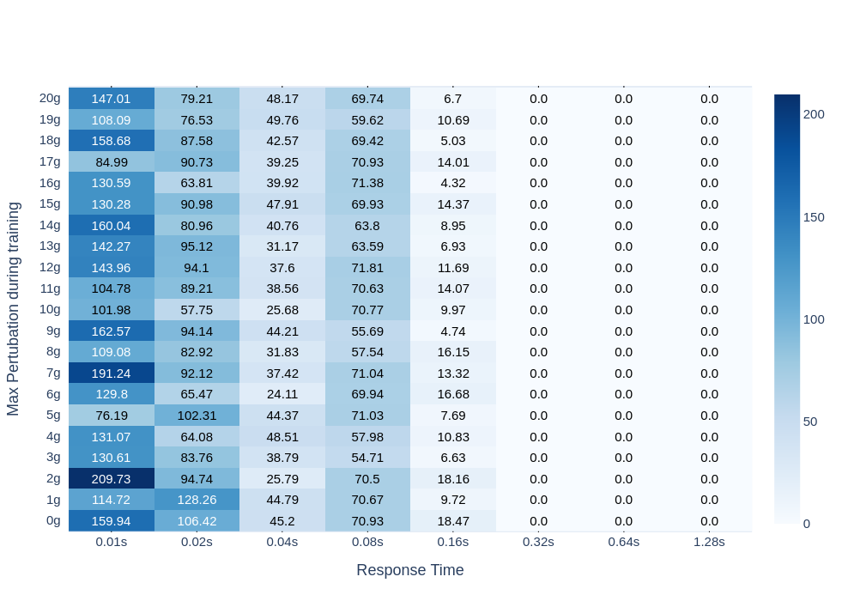
InvertedPendulum-V2 Jerk

Slide 25
InvertedPendulum-V2 Reward / Survival time in seconds

Slide 26
HalfCheetah-V2 Reward

Slide 27
HalfCheetah-V2 Reward

